Slide 1
Machine Learning
Loan Default @ Freddie Mac

Slide 2
Agenda
Problem Statement
Data Wrangling / Cleaning
Visualization / Feature Engineering
Modelling
Challenges / Future Steps

Slide 3
Problem Statement
What’s the question?
Will a client default on a loan?
When is it asked?
When an existing client applies for a loan
How do we answer it?
What features best answer this question?
Recall more important than precision for imbalanced data

Slide 4
Key Assumptions
‘Likely to default’ combined with actual defaults
Doesn’t make sense to predict ‘likely to default’
Sparse data so can NOT discard this many records
Combined classes w/ Pandas
‘Owner account’ = client
Drop ‘disponent’
Only use transactions from BEFORE a loan was issued
Orders table did not have dates, therefore must be dropped

Slide 5
Data Wrangling (SQL)
Load 7 tables (cleaned Date columns)
Drop Orders table
Key joins:
Only accounts w/ loans; drop the rest
Key filters:
Only transactions before loan date
Key columns:
Transaction / balance amounts
Min, max, mean, sum, count

Slide 6
Data Cleaning (Python)
SQL Alchemy to load SQL table into Pandas DataFrame
Create columns:
Birthdate / Age
Account date / Credit card date / Account age
Disponent (then drop non-Owners)
Drop columns:
ID columns
Redundant info (e.g. district, UE ‘95)
Fill N/A’s (mean value or ‘Unknown’)

Slide 7
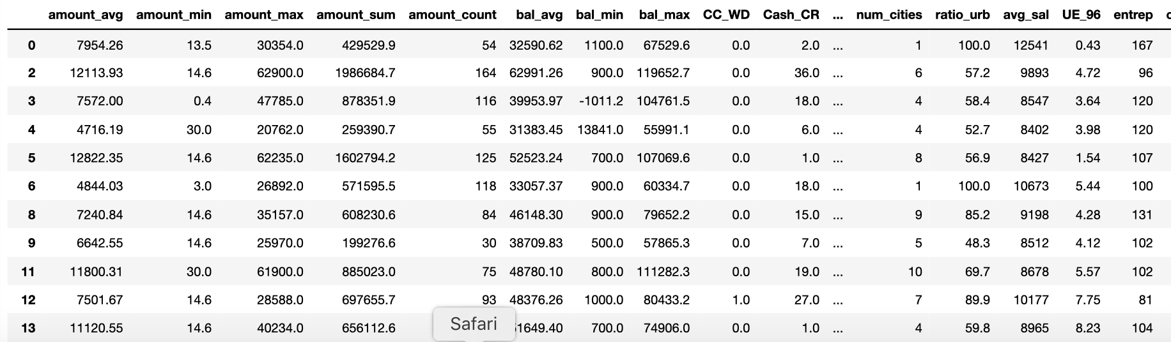
Data
Final DF: 682 rows x 41 columns (all Numeric)
Key columns:
Transaction type counts
Dummies: Region, card type, payment frequency

Slide 8
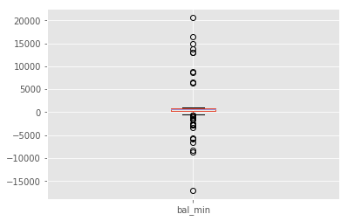
Visualization
Summary statistics
Box plots
Value counts
Bar graphs
Histograms

Slide 9
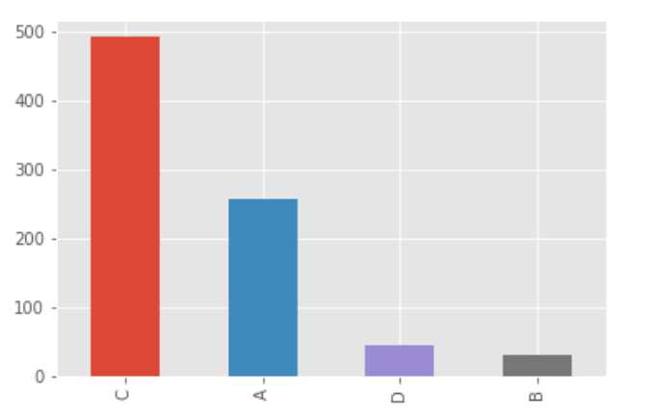
Value Counts – Loan Status

Slide 10
Feature Selection
Drop target! (ALL loan data)
Drop date columns
Drop redundant info (Credit, Debit, Demographics)
Transaction, balance, demographic, account, CC info remains

Slide 11
Modeling
Set X and y
Get dummies
One Hot Encoding (Drop first = True)
Pick 1 of 5 classification models
Train Test Split (Test_size = 25%)
Cross validation (K = 5, scoring = ‘F1’)
F1 is a combo of precision and recall well-suited for imbalanced data
Tune hyper parameters

Slide 12
Decision Tree
Advantages:
Easy to interpret
Handles outliers
Disadvantages:
Not very stable
Potentially over fitting to training sample
Max_depth = 12
Cross-Val F1 score = 0.59

Slide 13
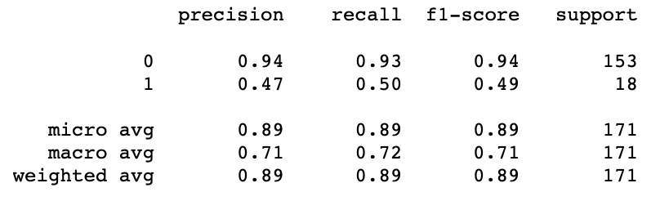
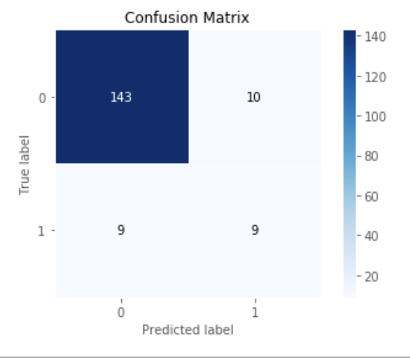

Slide 14
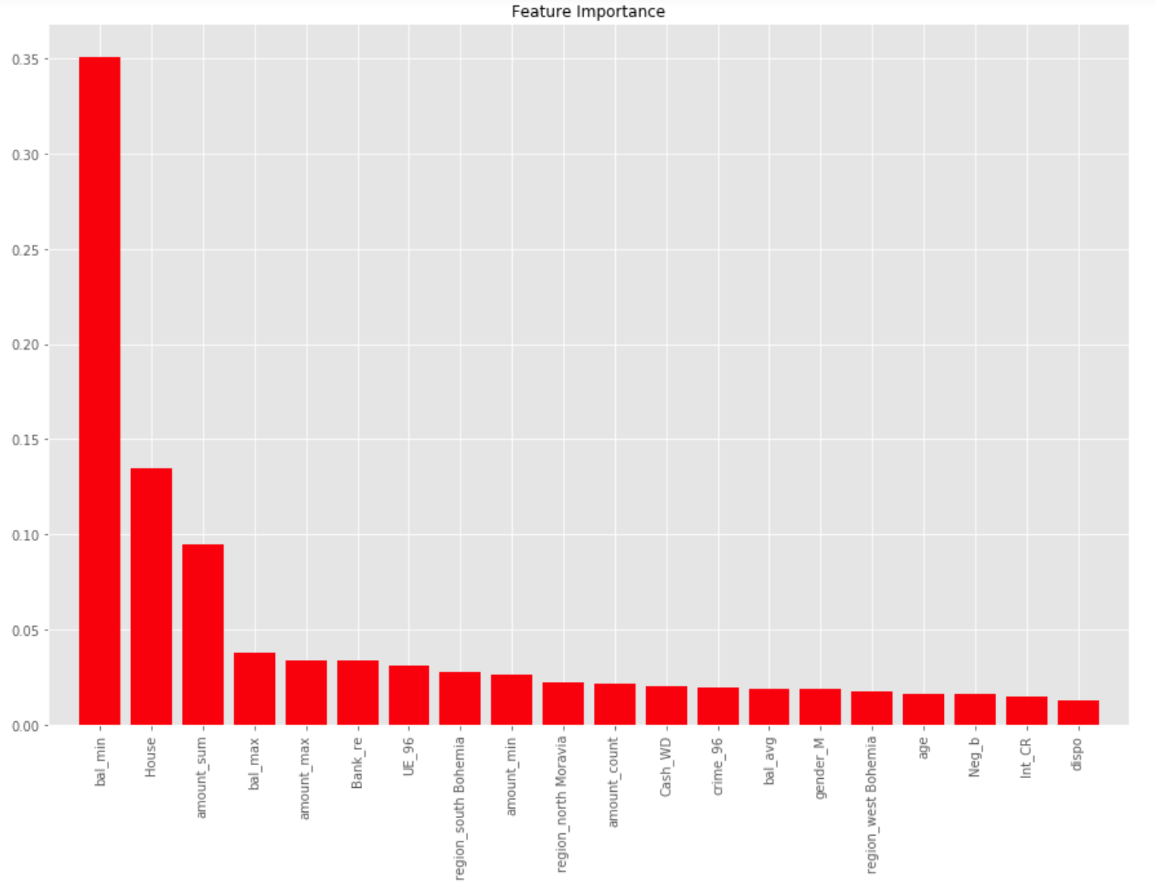

Slide 15
Decision Tree
Instructive to look at how tree splits
Informs feature selection
Features that are split highest and most often are most important
Bal_min
Amount_sum
Trans_type counts (Bank_RE, House, Neg_B, Cash_WD)

Slide 16
Random Forest
Similar advantages, but less explainable than DTree
We don’t know direction of association
Generalizes better than DTree (less over fitting)
max_depth = 12, n_estimators = 40
Cross Val F1 score = 0.57
More precise, but worse recall

Slide 17
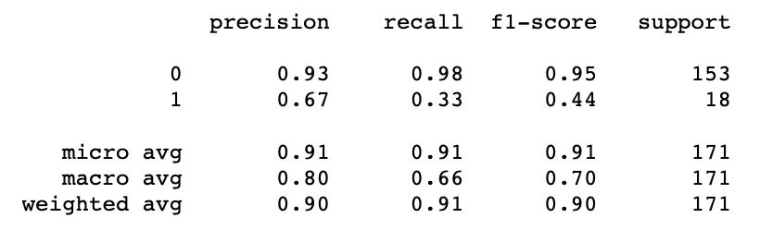
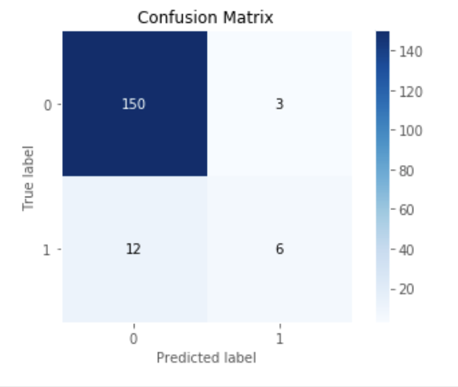

Slide 18
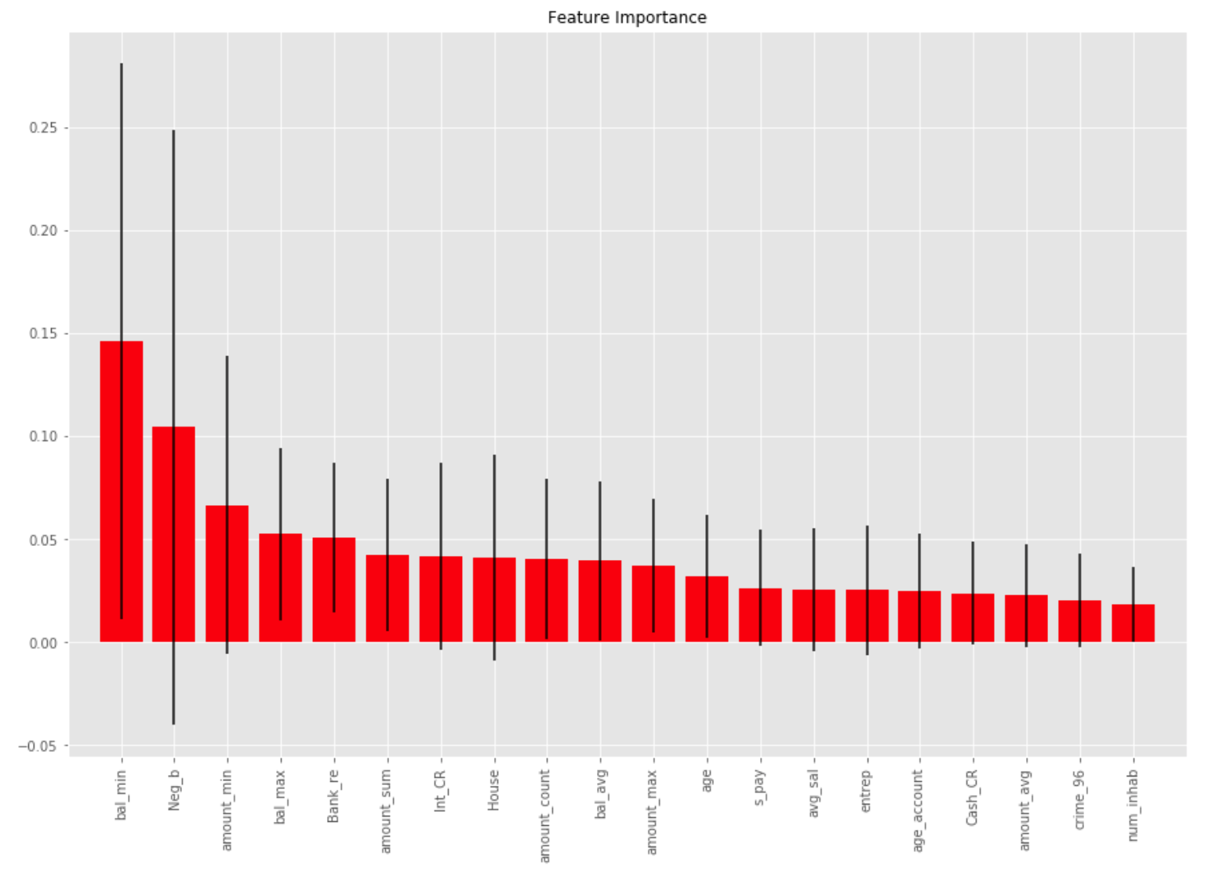

Slide 19
Logistic Regression
Scaled for interpretability
Model opted not to use regularization (high C)
max_iter = 20, penalty = ‘L1', C = 1000
Cross Val F1 score = 0.55

Slide 20
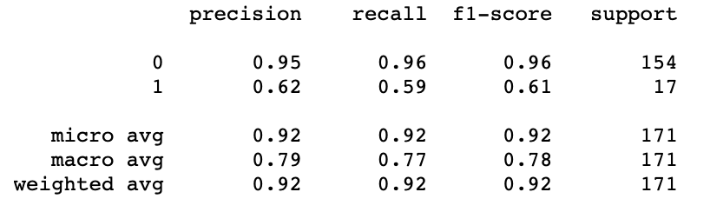


Slide 21
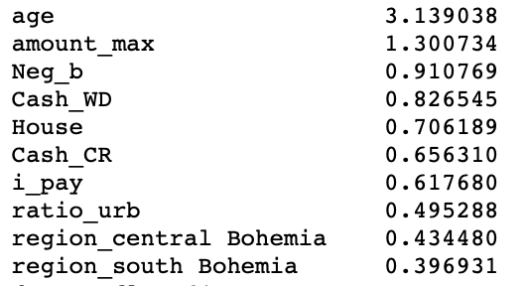
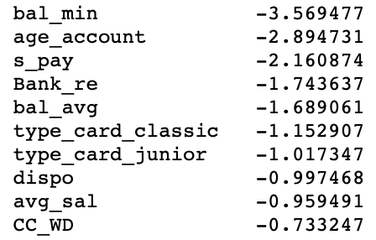
Coefficients

Slide 22
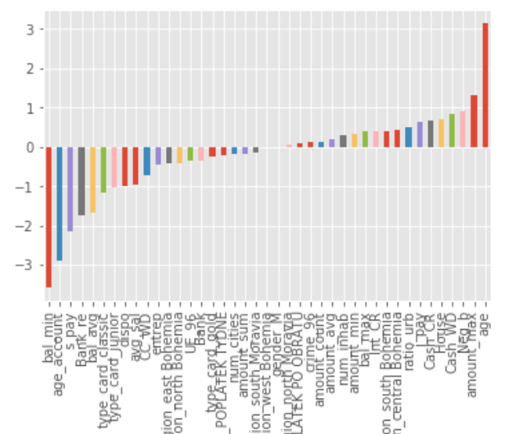

Slide 23
SVC and KNN
These methods both performed poorly
SVC F1 = 0.31, KNN F1 = 0.21
Unbalanced data set
Mostly predicted no default
Only predicted 3-6 defaults each, mostly correctly

Slide 24
Conclusions
LRegression is best model, but all models are insightful
Balance figures:
Min, Max, and Neg Balance Interest
Transaction amount figures:
Sum, Min, and Max
District, Age, and Account age
Cash Withdrawals and Household Transactions
Unimportant:
Payment frequency, credit cards, most demographic info

Slide 25
Challenges
Limiting transactions date:
Data Leakage warnings
Neg_B(alance) column leaking target data
Models were too good w/ Neg_B because they occur after default!
Had to rework Transactions / Orders tables in SQL
Confusion matrix:
Score by: Accuracy, recall, precision, or F1?
Depends on business objective, but F1 is most balanced
If cost of missing default high, then choose recall
If cost of misclassifying loan as default is high, then choose precision
Hyper tuning w/ out GridSearchCV was limiting

Slide 26
Future Steps
Further compare models
Why did models use similar, but different features?
Understand hyper tuning better (grid search, random state)
Explore Smote, boosting, pipelines, ensemble methods
Predict ideal term / amount for loan

Slide 27
Thank You!
Any Questions?

